Slide 1

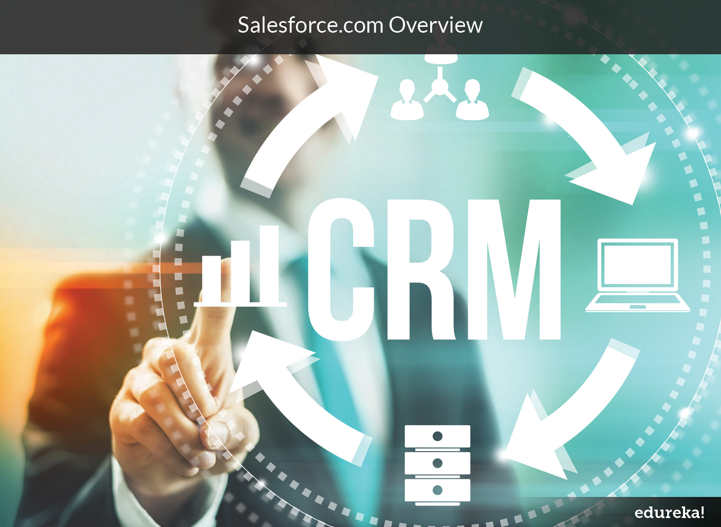
Presenter– Ronjay Chakraborty

Slide 2

Know your instructor
He has an overall 9+ years of experience across Indian and global organizations in the areas of technology consulting, IT strategy, business development and process consulting. Ronjay has led several key transformation projects across healthcare, retail, consumer goods and technology domains.
Ronjay Chakraborty MBA-IIM Lucknow
Expert, Salesforce with an IT MNC
Course link: http://www.edureka.co/crm-salesforce

Slide 3





What will you learn today?
In this session, we will understand about:
CRM Overview
Importance of CRM
Brief History
Introduction to Cloud Computing – SaaS and PaaS
Overview of Salesforce.com (SFDC)
Sales Cloud
Marketing Cloud
Service Cloud
Introduction to Business Objects
Salesforce Tools
Salesforce Analytics
Course link: http://www.edureka.co/crm-salesforce

Slide 4
CRM Overview

Slide 5
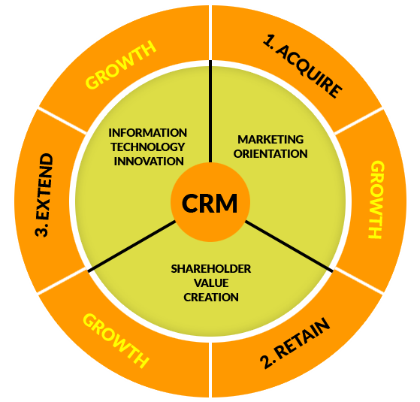
CRM Overview
Customer Relationship Management
Broadly defined, CRM is a strategy for managing a company’s interactions with clients and sales prospects and ensuring the ‘Connect’ sustains throughout the relation.
Purpose:
Retain existing clients
Energize dormant accounts / clients
Find new clients
Examples
New launch offers from your beloved cosmetics brand
Supermarkets / Retail brands giving out specific deals to customers
Course link: http://www.edureka.co/crm-salesforce

Slide 6
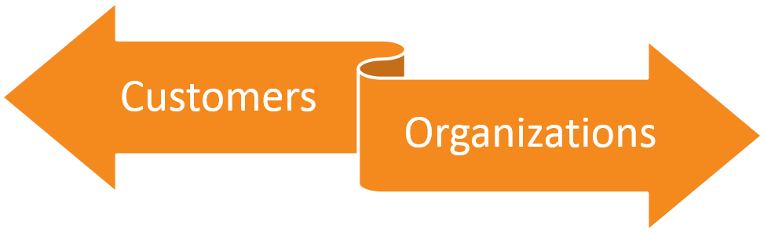
Importance of CRM
Sales team always had data on what is selling and who is buying. Then why is it that CRM has become so important in the current world?
Lack of timely data and fragmented systems meant unused data
Companies were worried about getting their house in order
Quick and specific response
Flexible resolutions
No rigidity
Less Bureaucracy
Easy information availability
Higher revenues through lesser personnel
Reduced maintenance (cost & time)
Activities targeted at revenue generation
Course link: http://www.edureka.co/crm-salesforce

Slide 7
Importance of CRM
CRM Systems
Continuous exchange of information across all customer channels/touch points
Personalised products/services based on specific needs and expectations
Consistent user experience across all touch-points
Real-time access to all customer information to enable quick decisions
Course link: http://www.edureka.co/crm-salesforce

Slide 8



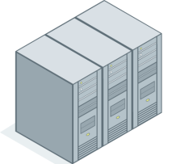





CRM – The Result (till now...)
Two main types of CRM systems
On Premise / Traditional systems (Siebel)
On Demand / Cloud Based Systems (SFDC)
Today
Cloud Computing Applications
1960’s
Mainframe
1980’s
Client/server
Course link: http://www.edureka.co/crm-salesforce

Slide 9
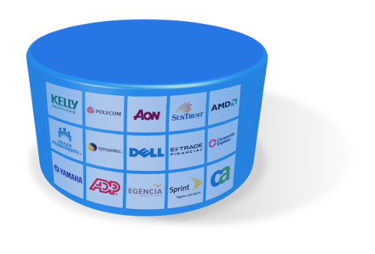
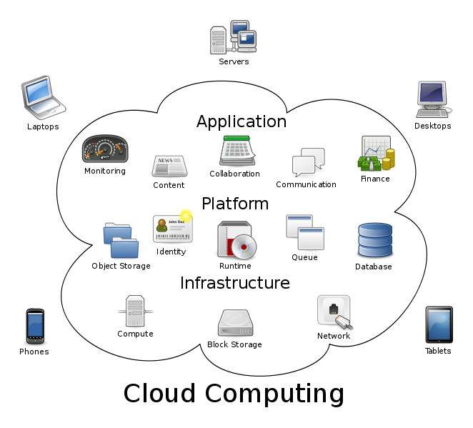
Introduction to Cloud Computing
Cloud computing refers to Internet-based computing
Involves shared resources, software and information provided via computers, mobiles
The term cloud is used to signify the Internet
Multi-Tenant:
Pay per Use:
Scalable:
No Capital Expenditure
Predictable Operating Costs
Scales With You
Course link: http://www.edureka.co/crm-salesforce

Slide 10
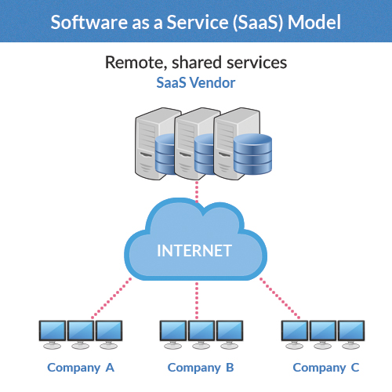
Software as a Service - SaaS
SaaS (Software as a service) is a model for software delivery
The entire service is managed centrally by the software company Inc. infrastructure, network, security etc.
Interested individuals and companies are allowed to “Rent" it rather than “Own “ it
Requires access through a Network (usually Internet but may also be an intranet)
Replicates a One-to-Many model (single instance, multi-tenant architecture)
No need for clients to worry about patch upgrades and version management as all features are updated automatically
Course link: http://www.edureka.co/crm-salesforce

Slide 11
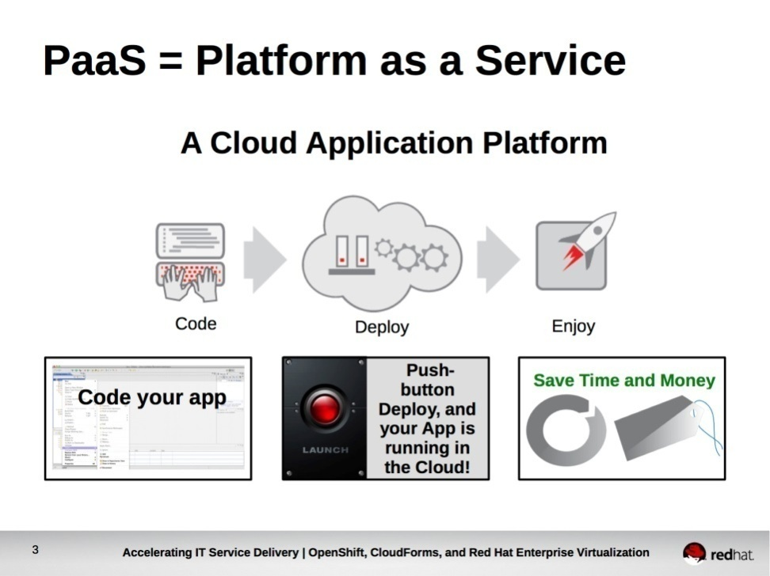
Platform as a Service - PaaS
Cloud computing has evolved to include platforms for building and running custom applications, a concept known as “Platform as a Service” (or PaaS)
Types of PaaS Solutions :
Social Application Platforms
Web Application Platforms
Business Platforms (e.g. Force.com)
Simplified Deployment
Lower Risk
Course link: http://www.edureka.co/crm-salesforce

Slide 12


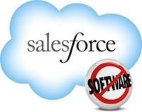






Introduction to Salesforce.com
PARTNERSHIP
SERVICES
Recruitment Planning
Partner Marketing
Partner Selling
Partner Analytics
Self Service Management
Web to Case
Channel Services
Automated Email Management
Knowledge Base
CONTENT
MARKETING
Search
Tagging
Subscriptions
Publishing
Collaboration
Recommendations
Workspaces
Campaign Management
Workflow Automation
Marketing Analytics
Search Marketing
Lead Management
Email Marketing
IDEAS
Post an Idea
Vote on Things You Like
Discuss Ideas with Community
SALES
Lead Management
Opportunity Management
Account & Contact Management
Activity Management
Approvals & Workflow
Territory Management
Partner Management
GOOGLE APPS
Salesforce for Google Apps
Salesforce for Google AdWords
APPEXCHANGE
Online marketplace of Apps
Many On-demand Apps
Easy Integration
Course link: http://www.edureka.co/crm-salesforce

Slide 13
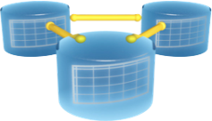




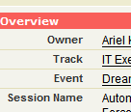





How Salesforce.com helps...
A
B
D
C
Database
Web Services API
Workflow Engine
Forms & Page Layout Editor
Access Control & Audits
End User Administration
Reporting & Analytics
Multi-Device
Clicks
Code
80%
20%
Coding Based systems
20%
80%
Course link: http://www.edureka.co/crm-salesforce

Slide 14
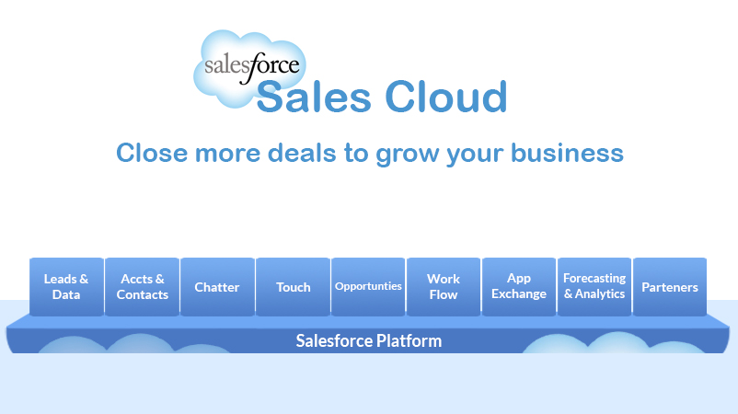
Sales Cloud – An Overview
Sales Cloud provides Sales reps with a tool that helps them to build stronger relationships with customers and close more deals since everything can be found at one place.
Course link: http://www.edureka.co/crm-salesforce

Slide 15
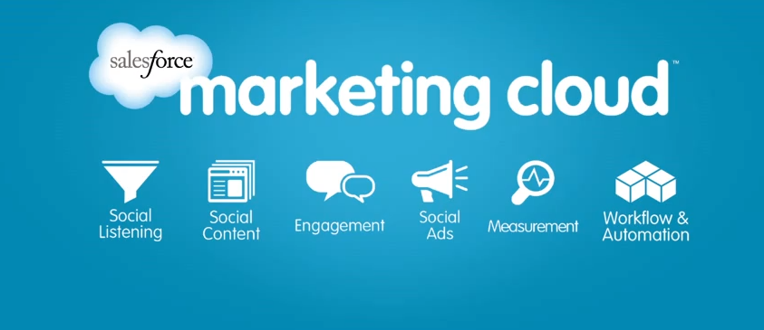
Marketing Cloud – An Overview
The Marketing Cloud is a collection of cloud-based marketing services that make internal marketing functions more efficient and external marketing programs more effective.
Course link: http://www.edureka.co/crm-salesforce

Slide 16
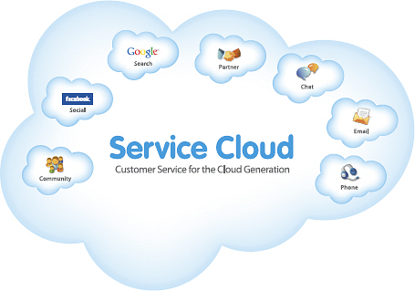
Service Cloud – An Overview
Service Cloud refers to providing customer Service through internet including managing the entire customer service cycle from raising customer service request to solving the request and informing the status of the request to the customer
Course link: http://www.edureka.co/crm-salesforce

Slide 17
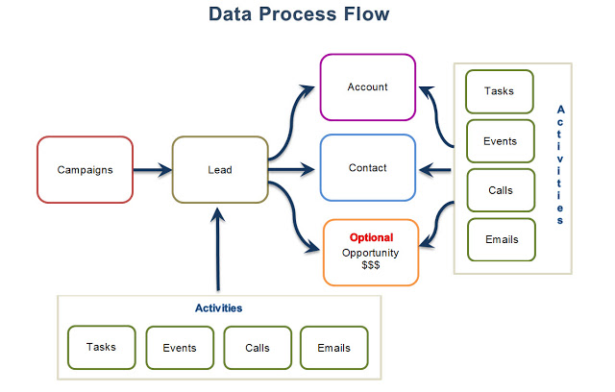
Handling Marketing through Salesforce.com
Course link: http://www.edureka.co/crm-salesforce

Slide 18
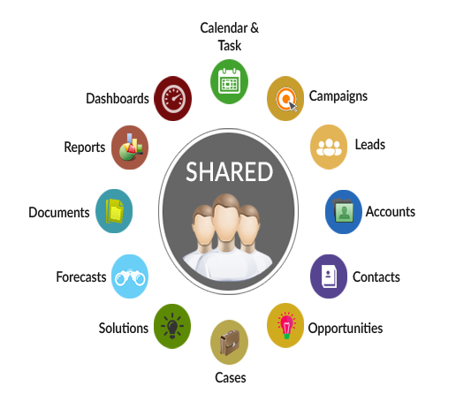
Introduction to Business Objects
Salesforce.com Objects involves understanding which data are a standard part of SFDC, which data need to be added as custom fields or custom objects, and which data need to be integrated from outside systems.
Two types of business objects:
Standard Objects
Custom objects
Course link: http://www.edureka.co/crm-salesforce

Slide 19
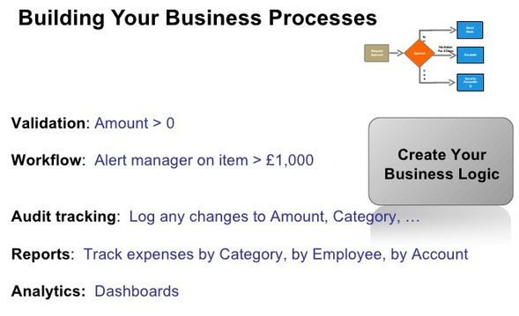
Salesforce Tools for your Business Processes
Salesforce Standard and Custom Objects
Standard & Custom Fields and Data Types
Relationships (Lookup & Master-Detail)
Page Layouts & Record Types
Validation Rules
Workflow Rules
Approval Process
Profiles
License
Sharing Settings and Roles
Tabs, Apps & Packages
Course link: http://www.edureka.co/crm-salesforce

Slide 20
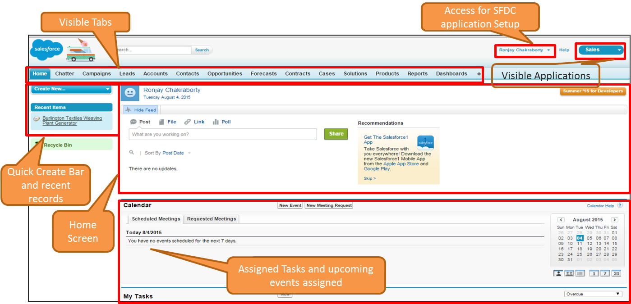
Simple User Interface of Salesforce.com
Course link: http://www.edureka.co/crm-salesforce

Slide 21

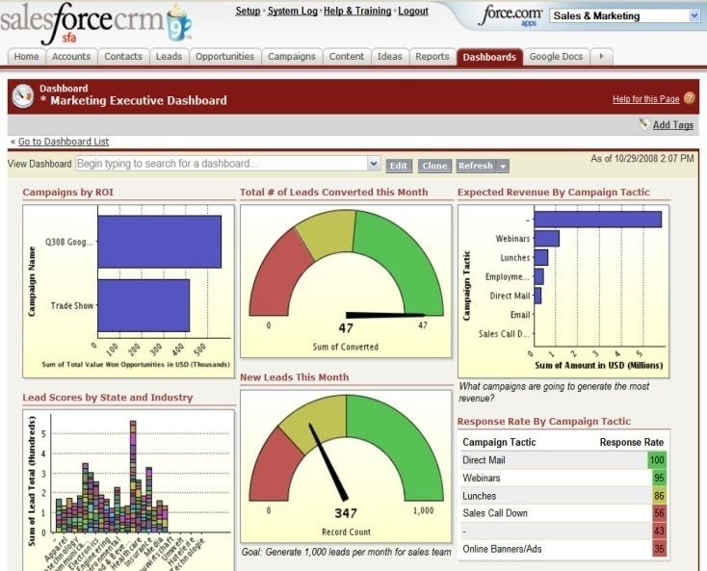


Salesforce Analytics
Two Analytics tools:
Reports
Dashboards
Real-Time Visibility with
Easy to Create Reports
Customizable by Business Users
Real-Time Reporting
Integrated Analytics Across All Apps
Security Controls
Mobile Access
Email Dashboard Delivery
Real-Time Updates
Real-Time Updates
Real-Time Analytics
Course link: http://www.edureka.co/crm-salesforce

Slide 22
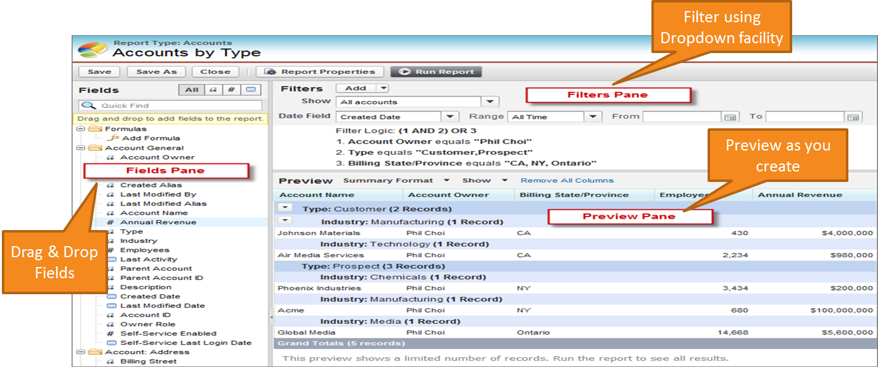
Reports
A report contains a set of data displayed in organized rows and columns, based on certain criteria thereby, helping to derive meaningful insights
Course link: http://www.edureka.co/crm-salesforce

Slide 23
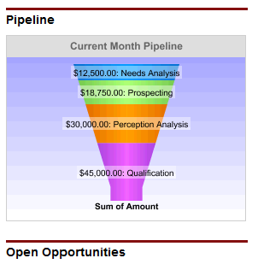
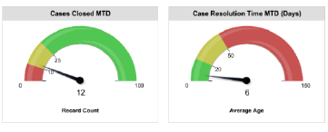
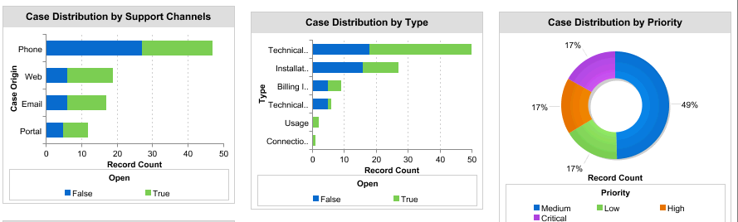
Dashboards
Dashboards are graphical representation of the results from reports. They provide a snapshot of key metrics and performance indicators for the organization.
Four Types of Dashboards
Table - Good for showing top five lists
Chart – Used to prepare various charts e.g. bar charts, line charts, pie
Gauge - Used to show progress towards a goal
Metric - Shows a single number
Course link: http://www.edureka.co/crm-salesforce

Slide 24

Certifications
Get Certified in CRM Salesforce by Edureka
Go to www.edureka.co/crm-salesforce
Batch starts from 10 October (Weekend Batch)
Timings: 8:30 AM to 10:30 AM
Edureka's CRM Salesforce for Beginners course:
Become an expert in CRM Salesforce by mastering concepts of CRM, its business implications and how Cloud computing is changing the way businesses use technology to engage with their customers.
Online Live Courses: 16 hours
Assignments: 12 hours
Project: 12 hours
Lifetime Access + 24 X 7 Support

Slide 25
Thank You
Questions/Queries/Feedback
Recording and presentation will be made available to you within 24 hours

